Slide 1

Cochran LLC PLC
Investment Insights

Slide 2
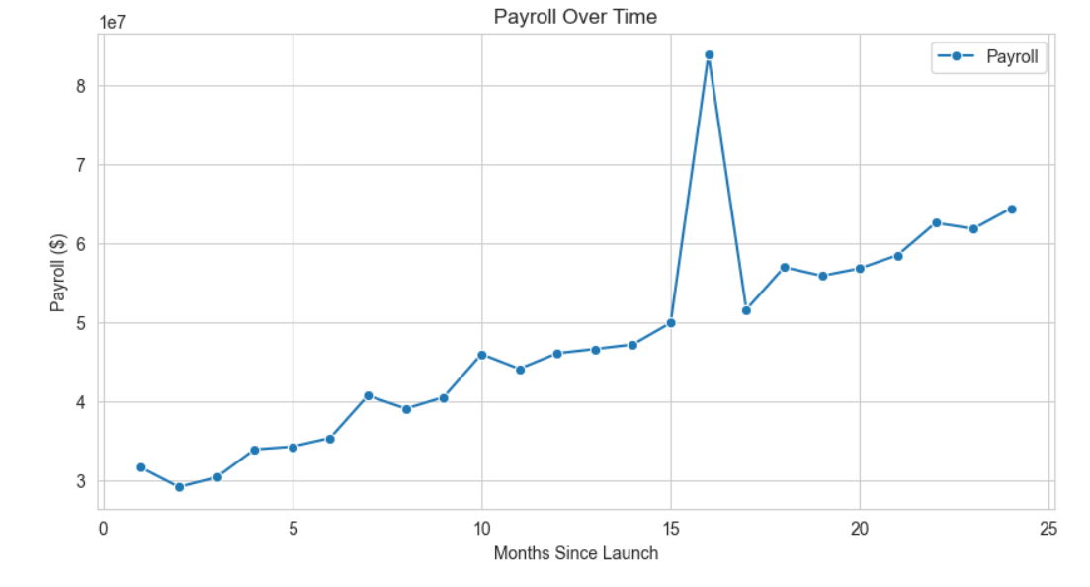
Current Situation:

Slide 3
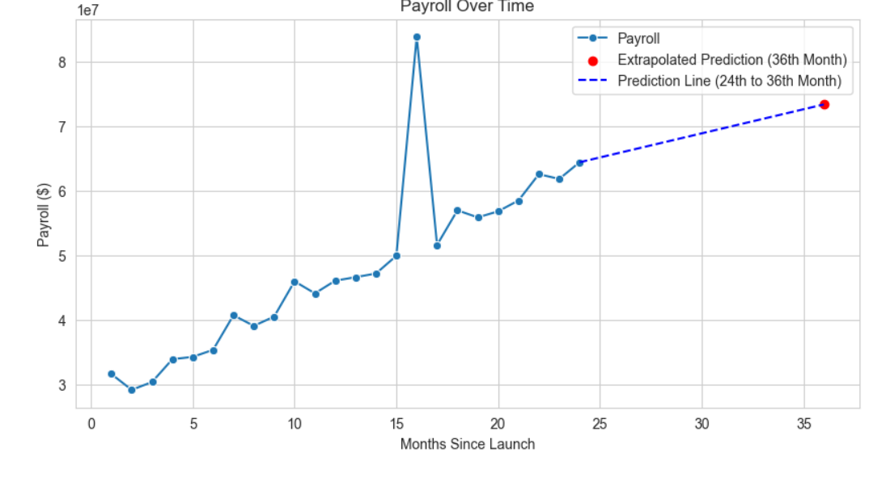
12-month Payroll Prediction:
Payroll in 36th month = $73422956.52
This suggests that the company is growing regularly and hiring more people.
Shows a positive outcome in the future in terms of payroll.

Slide 4
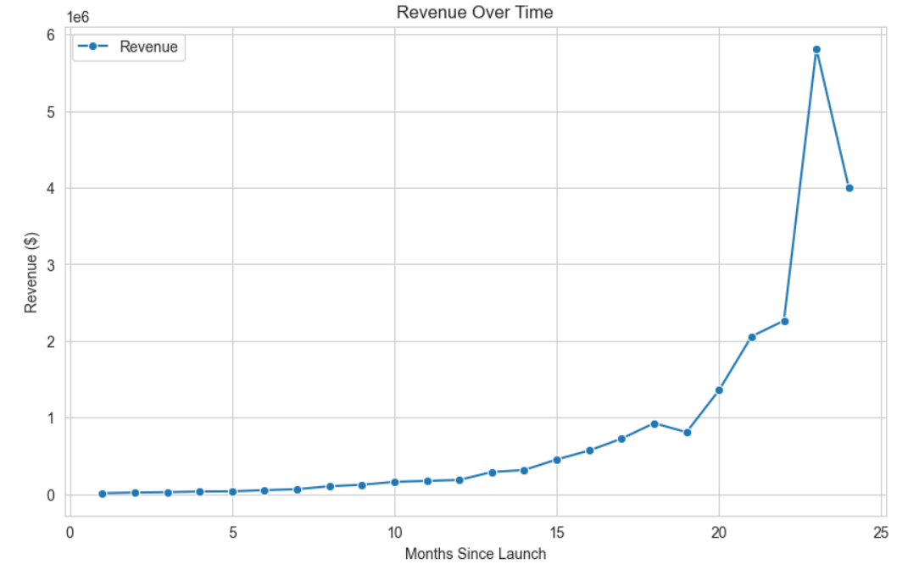
Current Revenue Situation

Slide 5
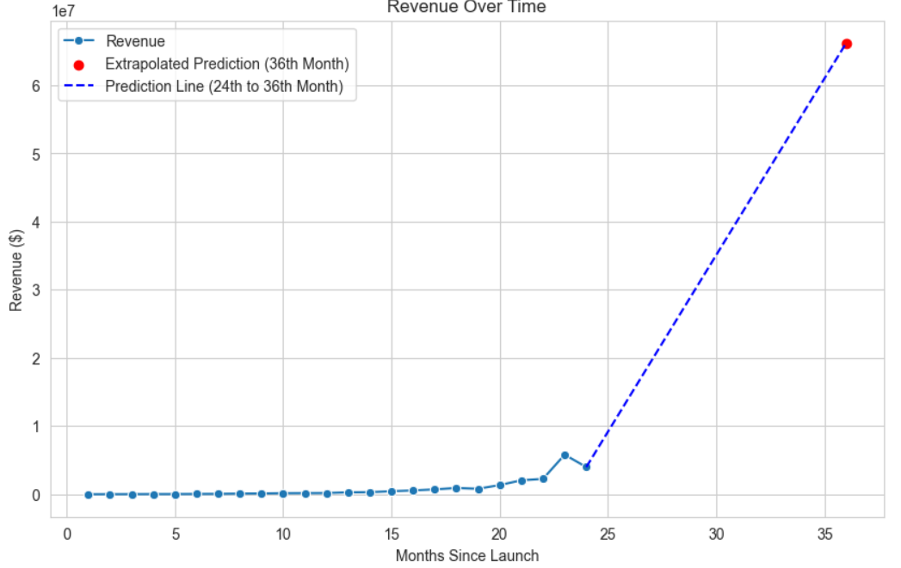
Predicted Revenue:
Revenue in 36th month = $ 66174993.22
This suggests that the company will grow regularly and exponentially.
Shows a positive outcome in the future.

Slide 6
Payroll and Revenue Comparison:
Revenue in 36th month < Payroll in 36th month
This suggests that the company is growing, but since payroll is more than revenue, this is a concern for investors. This can be a significant reason for future financial instability.

Slide 7
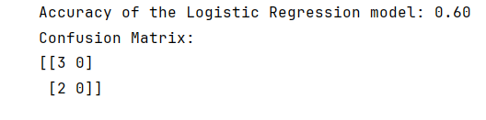
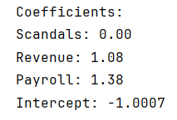
Media Coverage
Model Accuracy:
The probability of Negative Media Coverage is 100% as per the model.
Cause:
It is possible that this is because revenue is less than payroll but since our models lacks data it is hard to say that we are certain about it.
On top of that, our model’s accuracy for predicting media coverage is only 60%.
- Factors like Revenue and payroll can affect the outcome of media coverage.
Features Affecting Media Coverage Outcome:

